Slide 1


6th November 2026 - Ironhack
Green Light Analytics
We turn film data into clear, evidence-based production decisions.
Bindu Valmiki
Catarina Braga Macedo
Notes:
We are Green Light Analytics. A studio asked us one question: what kind of film should they make next to be both well rated and successful at the box office?

Slide 2

‹#›
Overview
Who we are
The client
Green Light Analytics helps film studios decide which movies to “greenlight”: approve and fund for production.
A small film production studio planning its next US cinema release. Its executives and production team need to choose a project that is both well rated and commercially successful.
The data
The decision
The IMDb Top 1000: the highest-rated films of the last century, with genre, age certificate, director, cast, audience and critic scores, number of votes and US box office.
Which genre to produce, which age certificate to target, which director to hire for the budget, and how much to invest in reaching a wide audience.
Notes:
We are Green Light Analytics. A studio asked us one question: what kind of film should they make next to be both well rated and successful at the box office?

Slide 3
‹#›
Business Questions
01
Rating vs. box office: Does a high rating mean high box office, or does popularity (number of votes) matter more?
02
Trends over time: How has the mix of top films changed over the decades, and which genres are rising?
03
Age certificate: Does a film's age rating affect how much it earns?
04
Genres: Which genres produce the most top-rated films, and which earn the most at the box office?
05
Critics vs. audiences: Do critics (Meta_score) and audiences (IMDb rating) agree on what makes a great film?
06
Talent: Which directors and actors consistently deliver highly rated and profitable films?
‹#›

Slide 4
Dataset
‹#›
🎬
1,000
highest-rated films on IMDb
📋
16
columns per film
📅
1920–2020
years covered
⚠️ Missing values
Certificate 101 · Meta_score 157 · Gross 169
🚧 Limits
Top films only · US box office only · not adjusted for inflation
Source: Kaggle, IMDb Movies Dataset (Top 1000)
Notes:
Every film here is already a hit with audiences, so we look at what the best films have in common.
Columns (not shown on the slide): title, year, certificate, runtime, genre, IMDb rating, Meta_score, director, 4 lead actors, votes, US gross.

Slide 5
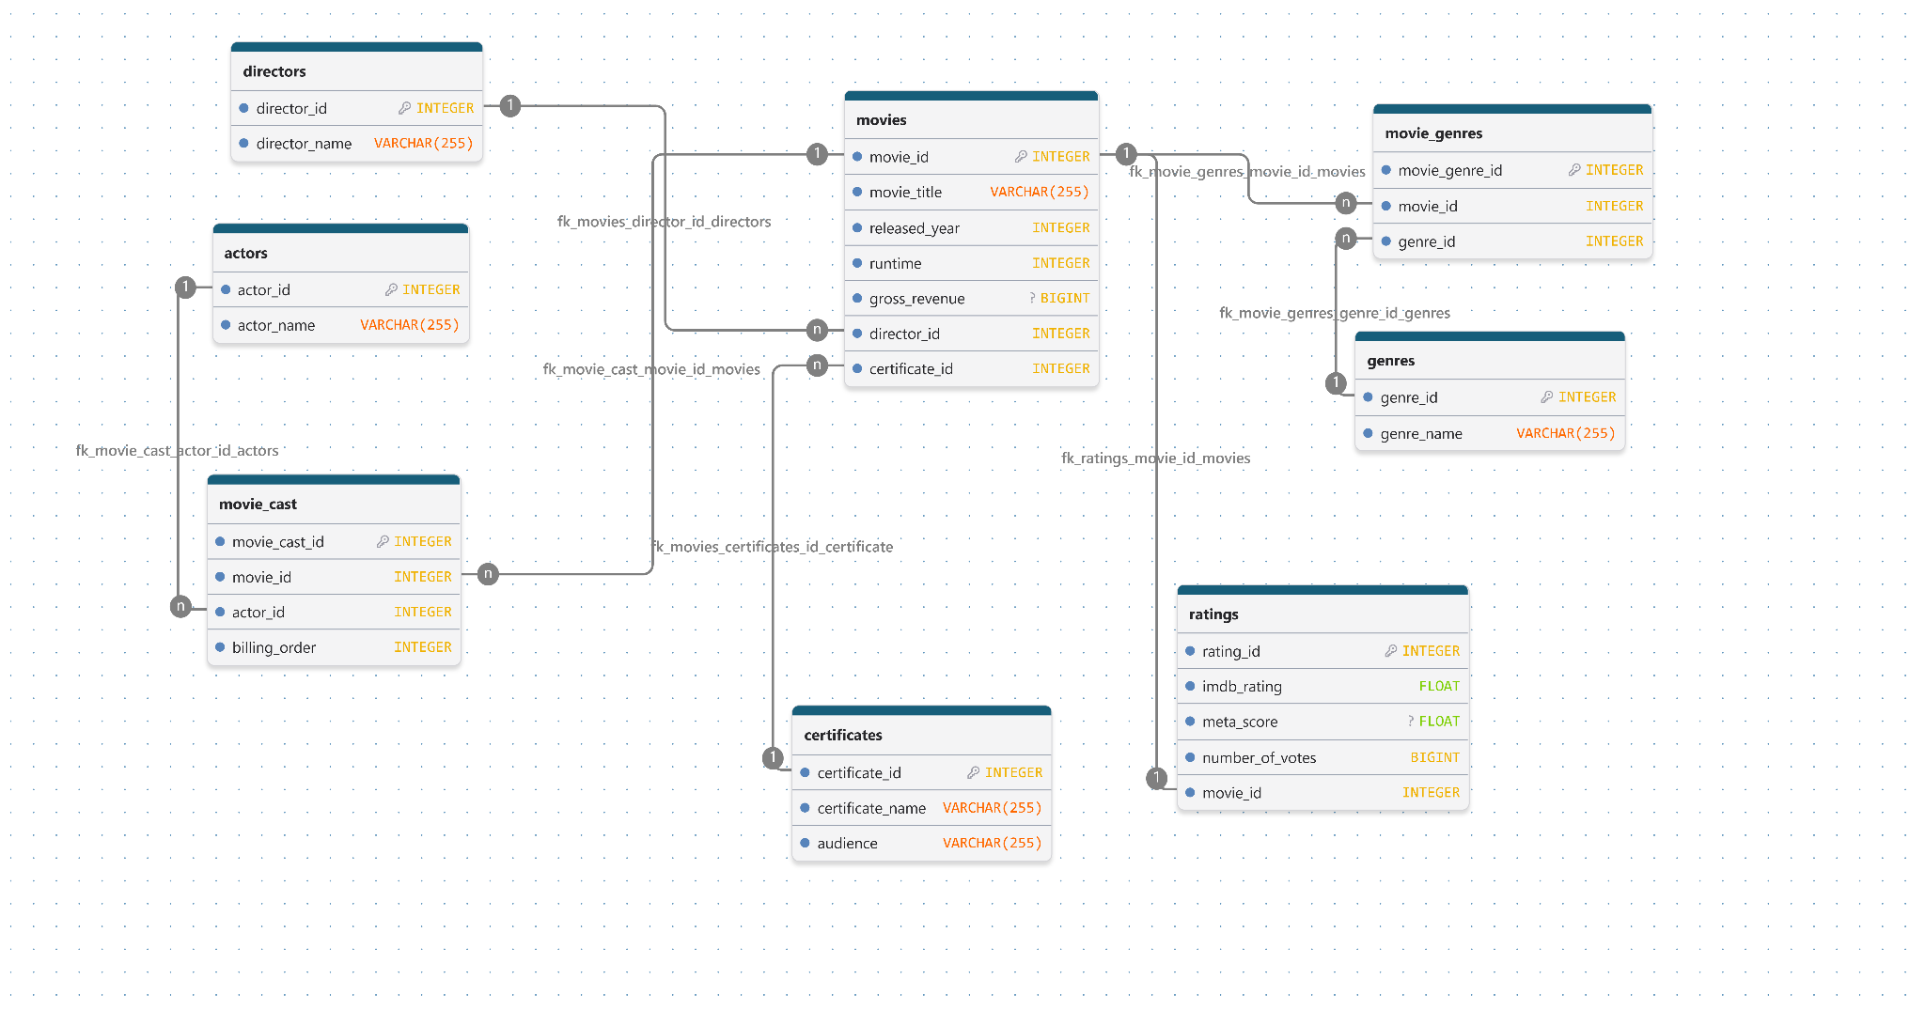
Database design
‹#›
8 tables: 4 lookup, 2 link, plus movies and ratings
Notes:
One film has many genres and many actors, so we used link tables. Each table was built in Python as a CSV and loaded into MySQL.
Row counts: directors 548, actors 2,709, genres 21, certificates 16, movie_genres 2,541, movie_cast about 4,000. ratings holds IMDb rating, Meta_score and votes per film.

Slide 6
Data preparation
‹#›
🧹
Clean in Python
fix types, split genres
📐
Design database
ERD with 8 tables
📄
Prepare tables
one CSV per table
🗄️
Load into MySQL
CSVs become tables
🔍
Analyse with SQL
answer the questions
8 data issues fixed
wrong types, genre lists, repeated titles
3 columns with gaps
Certificate, Meta_score, Gross: kept empty
8 tables checked
every key matched before loading
Notes:
Our rule was: never invent data. Missing box office and critic scores stay empty.
Examples of what we fixed: release year "PG" for Apollo 13 (set to 1995); runtime "142 min" and gross "28,341,469" stored as text; genre cells like "Crime, Drama" split into single genres; two different films called Drishyam (added a unique movie_id); 101 missing certificates labelled Unrated and grouped into 4 audience levels; poster link and overview columns dropped.

Slide 7
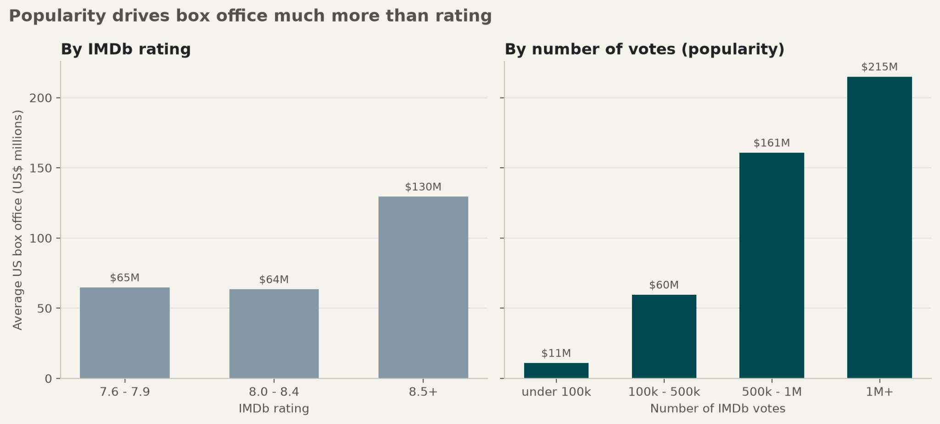
‹#›
Rating vs. box office: Does a high rating mean high box office, or does popularity (number of votes) matter more?
Films rated 7.6–7.9 and 8.0–8.4 earn the same: about $64M.
The most-voted films earn about 20× more than the least-voted: $215M vs $11M.
9 of the 10 biggest earners have 500k+ votes, but only one is rated above 8.5.

Slide 8
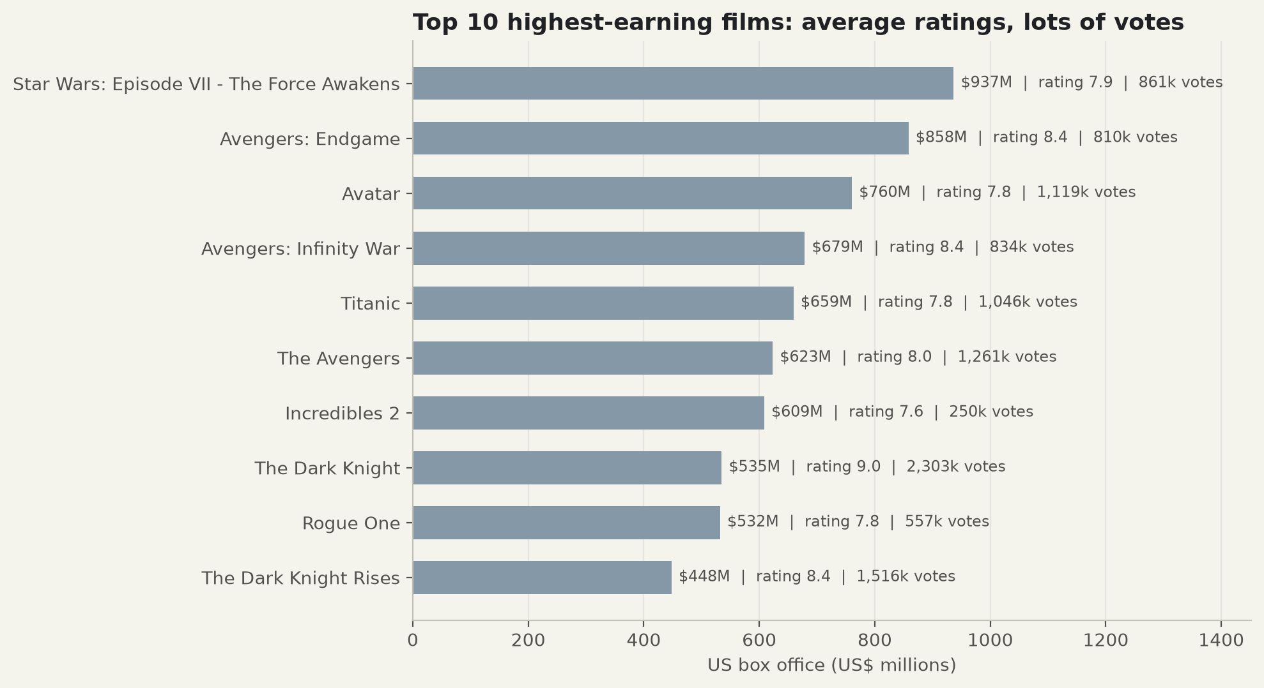
‹#›
Rating vs. box office
The biggest earners are popular, not the best rated.
Of the top 10 highest-earning films, only The Dark Knight is rated above 8.5. Most are between 7.6 and 8.4, below many films in the list. But 9 of the 10 have over 500,000 votes. Star Wars: The Force Awakens, the #1 earner ($937M), has a rating of 7.9.

Slide 9
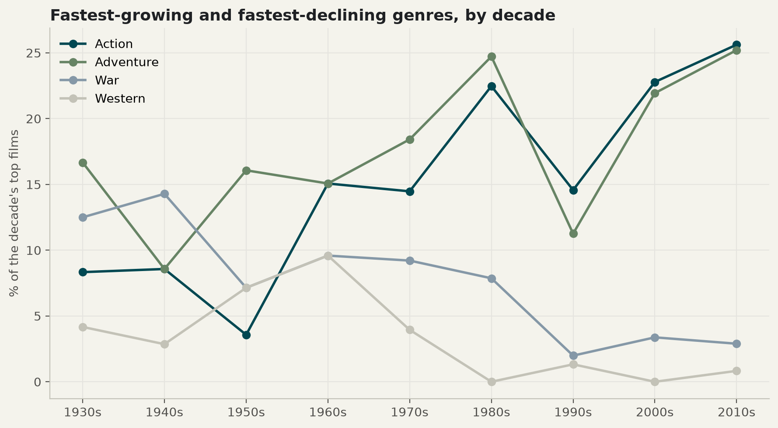
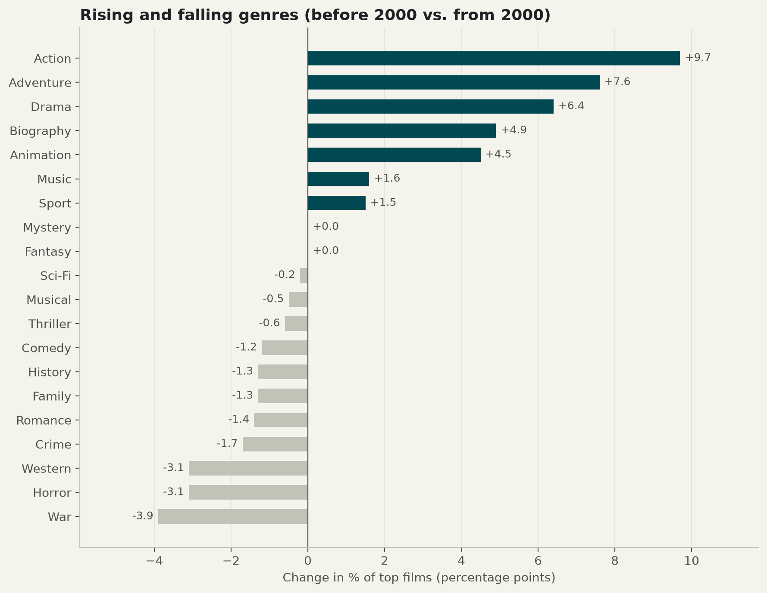
‹#›
Trends over time: How has the mix of top films changed over the decades, and which genres are rising?
Almost half of the top 1000 films are from the 2000s and 2010s.
Since 2000, Action (+ 9.7%) and Adventure (+ 7.9%) grew the most, while War, Western and Horror declined.
Drama is in 3 out of 4 top films, and runtime has stayed at about 2 hours since the 1960s.

Slide 10
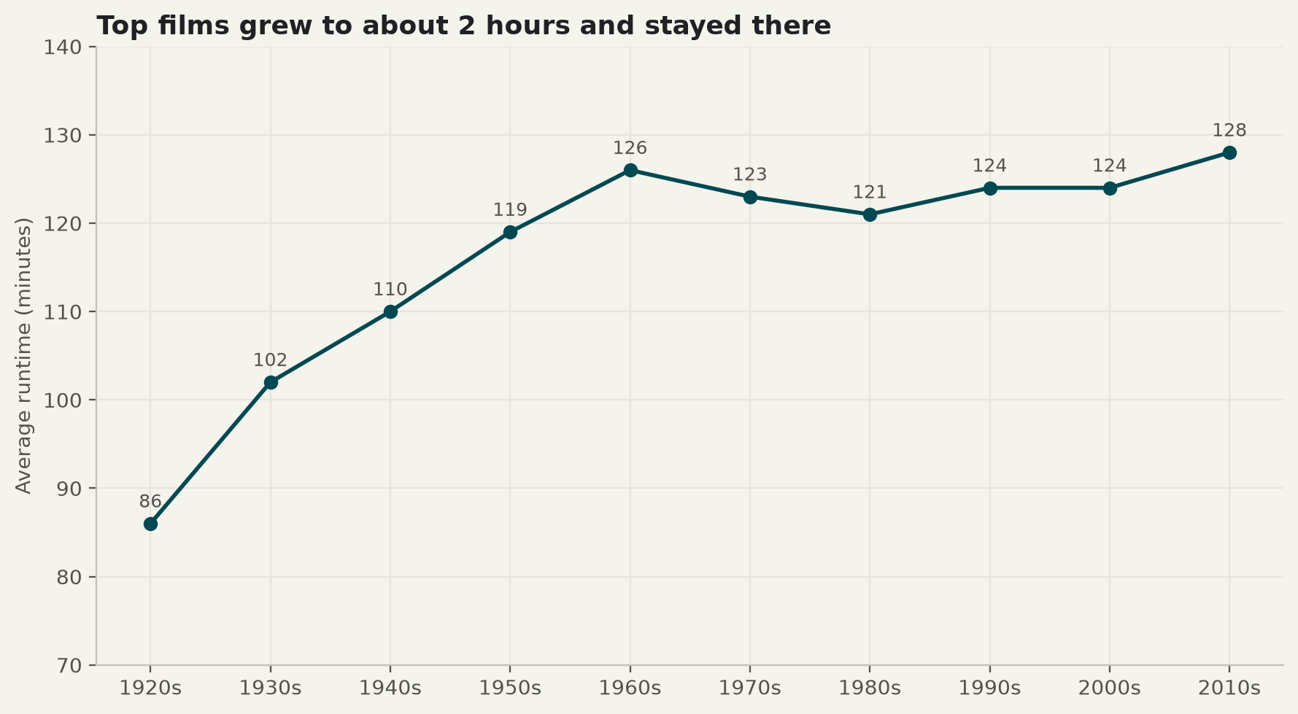
‹#›
Trends over time
Films got longer, then stabilised at about 2 hours.
Average runtime grew from 86 minutes in the 1920s to about 120 minutes by the 1950s. Since then it has stayed between 121 and 128 minutes.

Slide 11
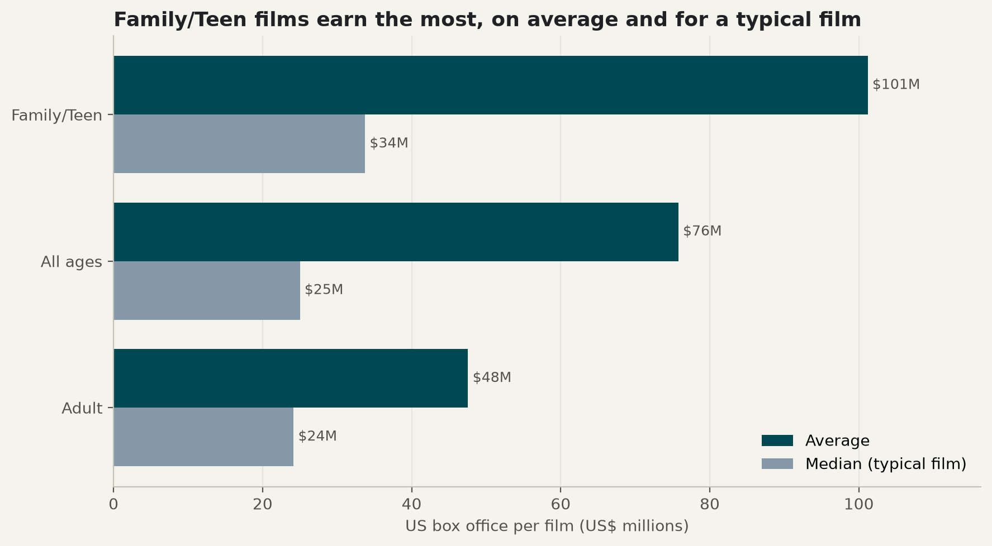
‹#›
Age certificate: Does a film's age rating affect how much it earns?
Family/Teen films earn $101M on average, vs $48M for Adult films.
38% of Family/Teen films earn above the average box office, vs 24% of Adult films.
Adult films are the most common in the list (345), but earn the least.

Slide 12
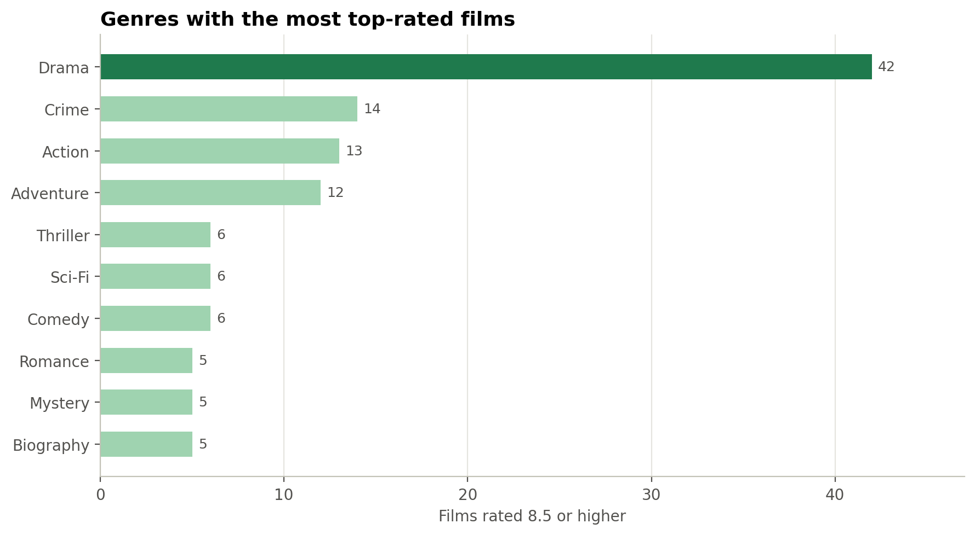
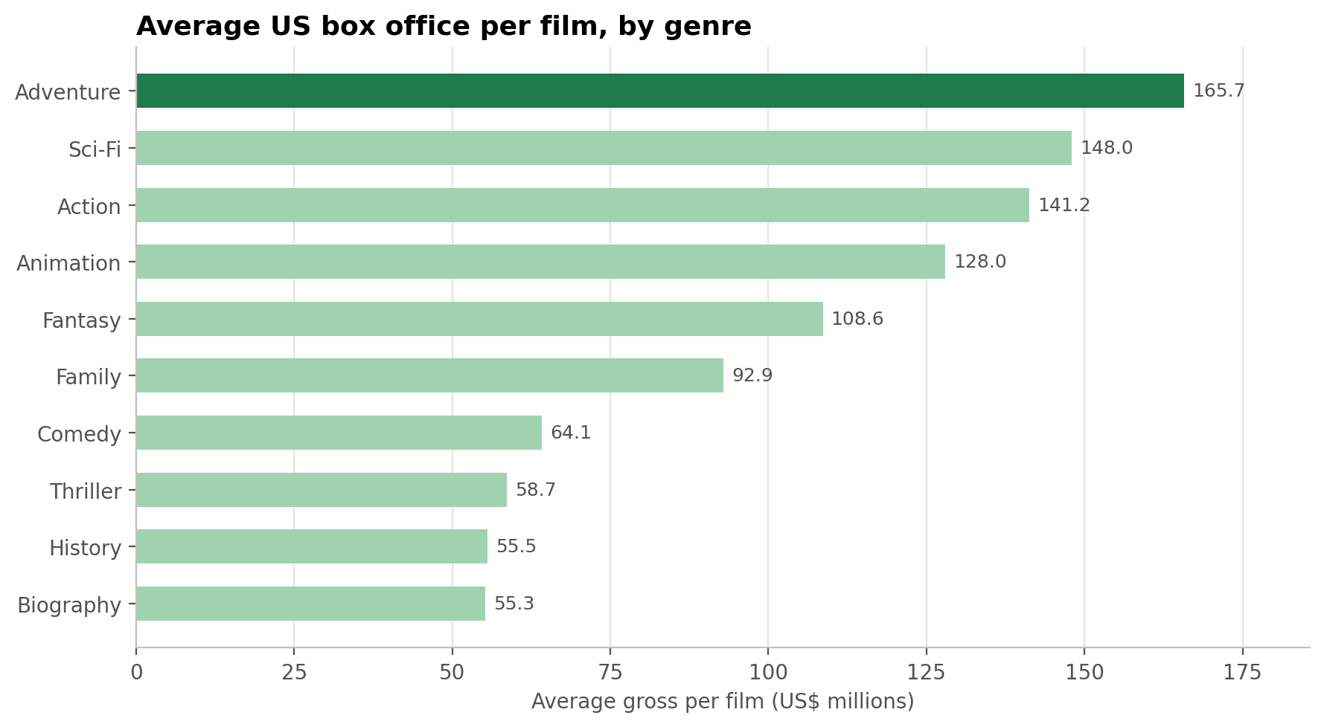
Genres
‹#›
SQL joins + Python charts
Which genres produce the most top-rated films, and which earn the most?
Insert chart:
Genres_with_the_most_top-rated_films.png
Insert chart:
Average_US_box_office_per_film,_by_genre.png
Drama wins on ratings (42 films rated 8.5+), but Adventure ,Sci-Fi and Action win on money.
US$166M, US$148M and US$141M per film, against US$46M for Drama.

Slide 13
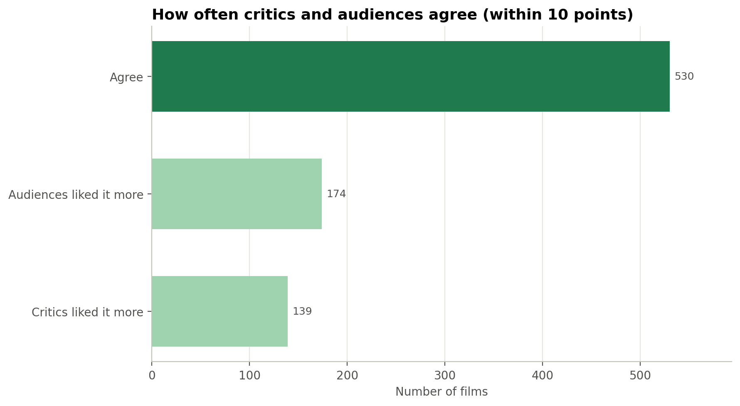
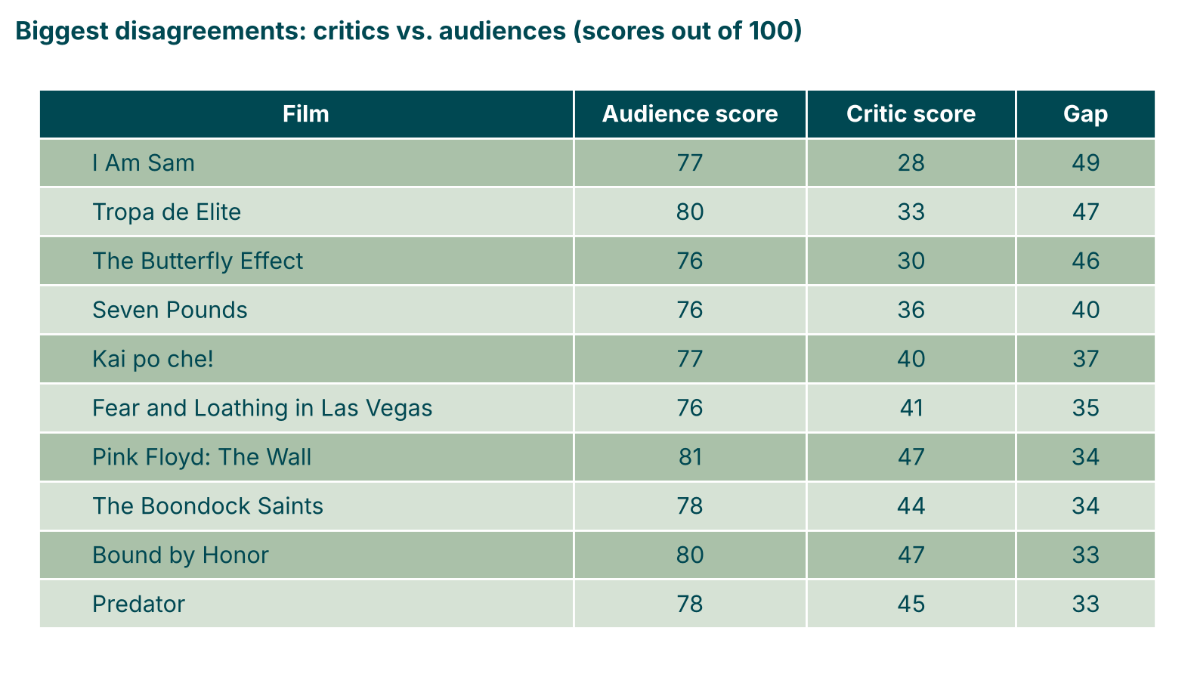
Critics vs. audiences
‹#›
SQL joins + Python charts
Do critics (Meta_score) and audiences (IMDb) agree on what makes a great film?
Insert chart:
How_often_critics_and_audiences_agree.png
Insert: Biggest disagreements (table from the notebook)
Mostly yes: audiences 79.3 vs critics 78.0 out of 100.
They are within 10 points on 530 of 843 films (63%).

Slide 14
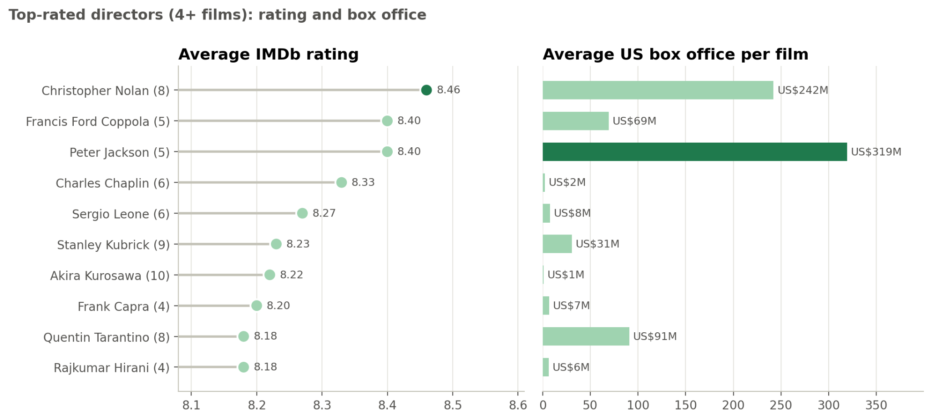
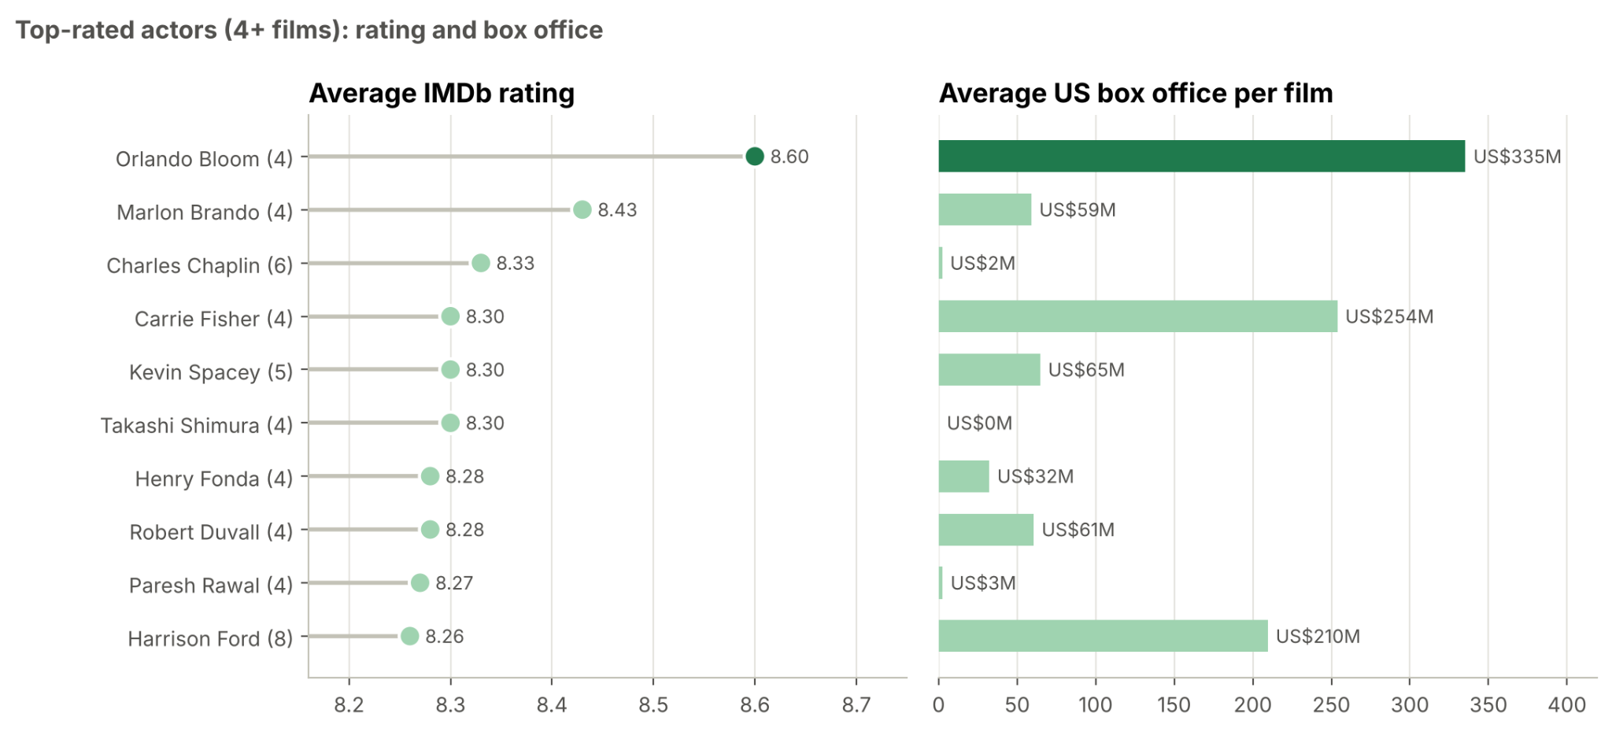
Talent
‹#›
SQL joins + Python charts
Which directors and actors deliver both high ratings and box office?
Insert chart:
Top_directors_rating_and_box_office.png
Insert chart:
Top_actors_rating_and_box_office.png
Christopher Nolan leads: 8.46 average rating and US$242M per film.
Peter Jackson (8.40, US$319M) also combines both. Top actor: Orlando Bloom (8.60, US$335M).

Slide 15
Key findings
‹#›
GENRES
US$166M
Adventure earns the most per film. Drama has the most top-rated films (42) but earns US$46M.
RATING VS BOX OFFICE
20x
Popularity beats rating: the most-voted films earn US$215M vs US$11M for the least-voted.
CRITICS VS. AUDIENCES
63%
of films: critics and audiences are within 10 points (79.3 vs 78.0 out of 100).
DECADES
1 in 4
Action and Adventure are rising: about 1 in 4 top films since 2000 (was 1 in 7). Drama is in 3 of 4.
TALENT
8.46
Christopher Nolan: highest director rating, and US$242M per film.
CERTIFICATE
US$101M
Family/Teen films earn the most, vs US$48M for Adult. 38% beat the average box office (24% of Adult).
Notes:
Drama wins on quality, Adventure and Action win on money. Critics and audiences mostly agree. Nolan is the best director on both rating and box office.

Slide 16
Business recommendations
‹#›
GENRE
Action/Adventure with a strong dramatic story: they earn the most per film (US$166M and US$141M).
LENGTH
About 2 hours long.
AUDIENCE RATING
Aim for Family/Teen (PG-13 or equivalent): the widest paying audience, US$101M vs US$48M for Adult.
REACH, NOT PERFECTION
A rating of 7.5+ is enough. Marketing, franchise potential and broad appeal drive revenue.
TALENT
Proven directors: Christopher Nolan (8.46, US$242M per film) or Peter Jackson (8.40, US$319M).
NEXT STEP
Add production budgets to measure return on investment.
Notes:
Not every studio can afford Nolan, so we give a big-budget and a smaller-budget option. We don't have budget data yet, which is the next step.

Slide 17
Lessons learned
‹#›
What we learned
Limits of the analysis
Check the values, not just the types: one release year was "PG".
CAUSATION
Correlation, not causation, and only top-rated films (no failures to compare with).
Missing data is a decision: we kept it empty instead of guessing.
BOX OFFICE DATA
US box office only, not inflation-adjusted. 831 of 1000 films have box office data; a few blockbusters boost the averages.
A good database design (link tables) makes the SQL much easier.
CERTIFICATES AND YEARS
Mixed certificate systems (India, US, TV) grouped into audience levels. Few films in the 1920s and 2020s.
Agree on column names as a team before merging notebooks.
Notes:
Replace these with your own words: these are suggestions from our work.

Slide 18
Thank you!
Any questions?
GITHUB REPOSITORY
github.com/catarina-bm/first_project
Bindu Valmiki
Catarina Braga Macedo

